Slide 1
Supporting your BlackBerry 10 application after launch
COM102
Eric Harty
May 1-3, 2012

Slide 2
A bit about myself Exactly who is Eric Harty?
Publishing under the name Ebscer since May 2009
Mostly Puzzle and Strategy games
Primary focus is on the BlackBerry Platform

Slide 3
Supporting your App Post-Launch Releasing Version 1.0 is not the end
Releasing in BlackBerry AppWorld can not be the end point

Slide 4
Supporting your App Post-Launch Releasing Version 1.0 is not the end
Releasing in BlackBerry AppWorld can not be the end point
Promoting the app
Supporting the app
Updating the app

Slide 5
If you build it, they probably won’t come
Why you need to promote your app

Slide 6
Promoting your Application It is easier then you think
Hoping that you get noticed will not work
Wishing for the best is not a marketing plan
You don’t need to spend lots of money
It is easier to promote a good app
The best thing you can do is be involved in the community

Slide 7
Be Loud, Be Proud, Be Cool. ❤ your App

Slide 8
Be Loud, Be Proud, Be Cool. ❤ your App
Tell people about your app

Slide 9
Be Loud, Be Proud, Be Cool. ❤ your App
Tell people about your app
Everyone

Slide 10
Be Loud, Be Proud, Be Cool. ❤ your App
Tell people about your app
Everyone
Blogs

Slide 11
Be Loud, Be Proud, Be Cool. ❤ your App
Tell people about your app
Everyone
Blogs
Friends & Family

Slide 12
Be Loud, Be Proud, Be Cool. ❤ your App
Tell people about your app
Everyone
Blogs
Friends & Family
Fans of your previous apps

Slide 13
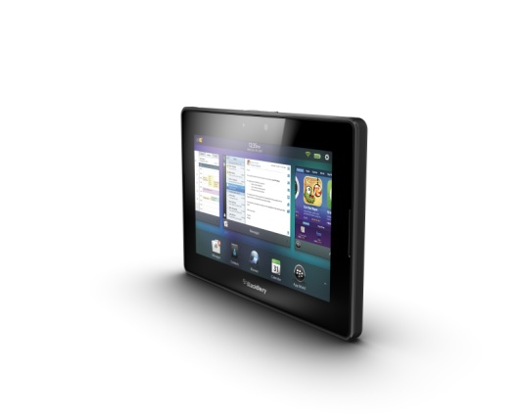
Everything is Marketing As in everything…
You can get good publicity by
Providing solid customer support
Speaking your mind
Helping out other developers

Slide 14
Providing great customer support
The bar is set shockingly low

Slide 15
Customer Support There is no avoiding this
Your app is not as intuitive as you think it is…
You will get complaints
You will get feature requests
You will get frustrated users

Slide 16
View Customer support as a positive activity

Slide 17
View Customer support as a positive activity
Everything is Marketing
Use the low expectations to your advantage

Slide 18
View Customer support as a positive activity
Everything is Marketing
Use the low expectations to your advantage
Listen to complaints
Every complaint is valuable feedback

Slide 19
View Customer support as a positive activity
Everything is Marketing
Use the low expectations to your advantage
Listen to complaints
Every complaint is valuable feedback
Consider feature requests
These users are trying to help you

Slide 20
Not Just Email (Although mostly email)
Customer support is about communicating with users in any form. (Even if they are not trying to communicate with you).
Twitter
Blog comments
Forums
AppWorld reviews

Slide 21
Updating your Application
Version 1.0 is not good enough

Slide 22
Version 1.0 is not good enough Don’t quit early
Point of updates is to…
Fix bugs
Add features
Apply feedback
Generate publicity

Slide 23
Everything is (still) marketing Including Updates
Updating your app is marketing

Slide 24
Everything is (still) marketing Including Updates
Updating your app is marketing
Give the blogs a reason to mention you

Slide 25
Everything is (still) marketing Including Updates
Updating your app is marketing
Give the blogs a reason to mention you
Remind users that your app exists

Slide 26
Everything is (still) marketing Including Updates
Updating your app is marketing
Give the blogs a reason to mention you
Remind users that your app exists
Give users a chance to review your app

Slide 27
Everything is (still) marketing Including Updates
Updating your app is marketing
Give the blogs a reason to mention you
Remind users that your app exists
Give users a chance to review your app
Give users a reason to love your app

Slide 28
Make use of feedback (The thing I was talking about 5 minutes ago)
Getting feedback is only useful if you actually make use of it.
Address complaints
Add new features
Make common tasks easier

Slide 29
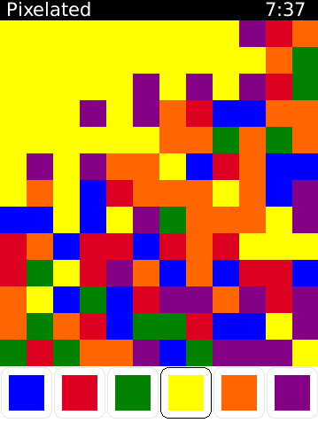
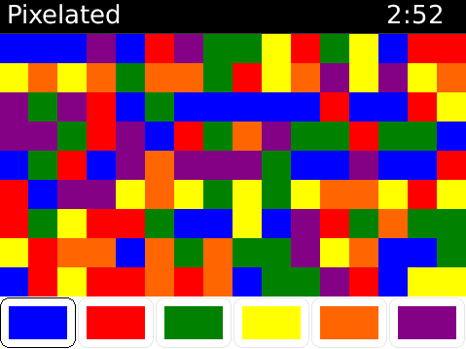
Address complaints Ignoring them is not an effective strategy
For every complaint, you need to assume that there are more users that quietly stopped using the app.
V2.3
V2.4

Slide 30
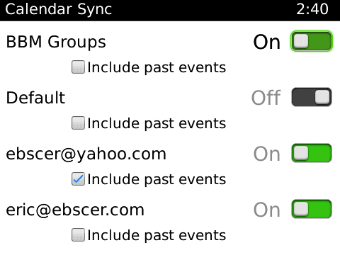
New Features Adding these are fun!
Listening to feed back can lead to new features that fit use cases other then your own.

Slide 31
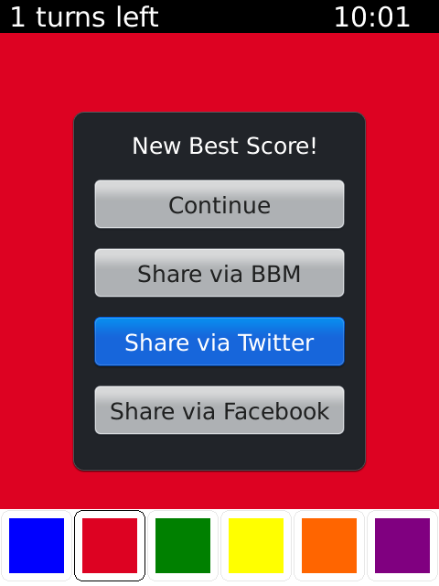
Help users do what they want even when they don’t request the feature
Implicit feature requests
or why Twitter incorporated the #hashtag @user and RT

Slide 32
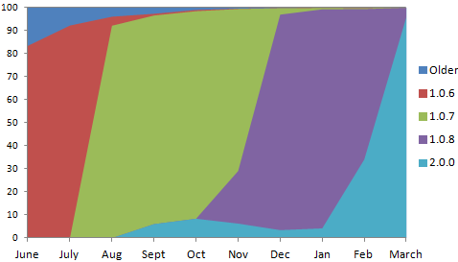
New features And why you can safely ignore legacy OS versions
Use BlackBerry 10 features to the fullest. PlayBook users have been very quick to upgrade, and there is no reason to expect BlackBerry 10 to be any different.

Slide 33
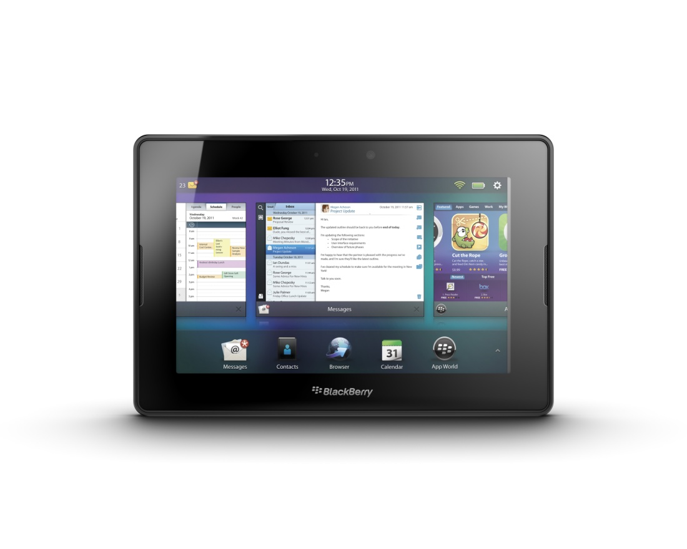
BlackBerry 10 Offers more than the “BlackBerry Tablet OS”
PlayBook apps will work on BlackBerry 10, but that does not imply that you shouldn’t look to upgrade your app

Slide 34
BlackBerry 10 No app is an island
Take advantage of what BlackBerry 10 has to offer
Look like Research In Motion
Follow the default BlackBerry 10 design
Include swipe-down menus
Use default colour schemes

Slide 35
BlackBerry 10 No app is an island
Take advantage of what BlackBerry 10 has to offer
Look like Research In Motion
Follow the default BlackBerry 10 design
Include swipe-down menus
Use default colour schemes
Connect to other apps
Integrate with native services
Contacts, E-mail, and BBM

Slide 36
BlackBerry 10 No app is an island
Take advantage of what BlackBerry 10 has to offer
Look like Research In Motion
Follow the default BlackBerry 10 design
Include swipe-down menus
Use default colour schemes
Connect to other apps
Integrate with native services
Contacts, E-mail, and BBM
Add social features
Integrate with Facebook, Scoreloop, and BBM

Slide 37
Advantages of BBM Share, Share, Share...
Advantages of integrating BBM

Slide 38
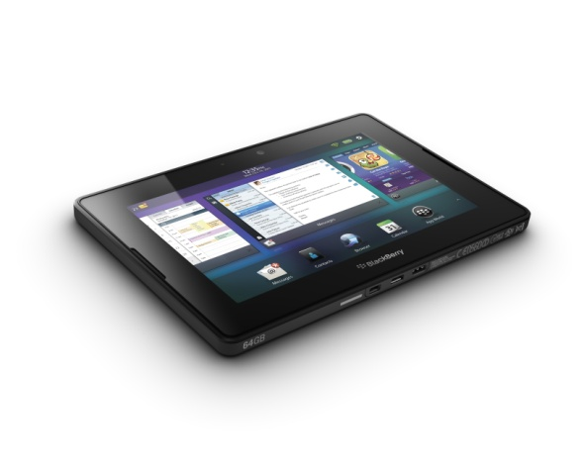
Work with RIM They really do want to see you succeed
The easiest way to get promoted within AppWorld is to add features that show off BlackBerry’s strengths
This means BlackBerry 10
Flow
Connect
Extend

Slide 39
Questions?
What questions do you have?

Slide 40
THANK YOU
COM102
Eric Harty
May 1-3, 2012

